Slide 1




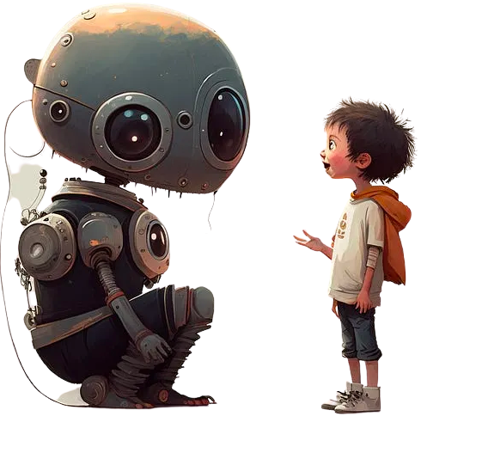
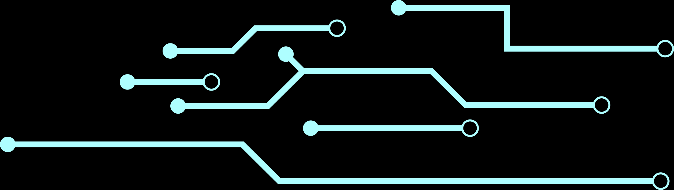
MEET WITH
CHAT-GPT(3)
BOISGUENE RUBBENS
Winter Camp ARHT
Jan 2023

Slide 2



Table Of Content
What is chat-GPT?
Who's behind it ?
Why the hype?
Limitations
Use cases
Practice

Slide 3

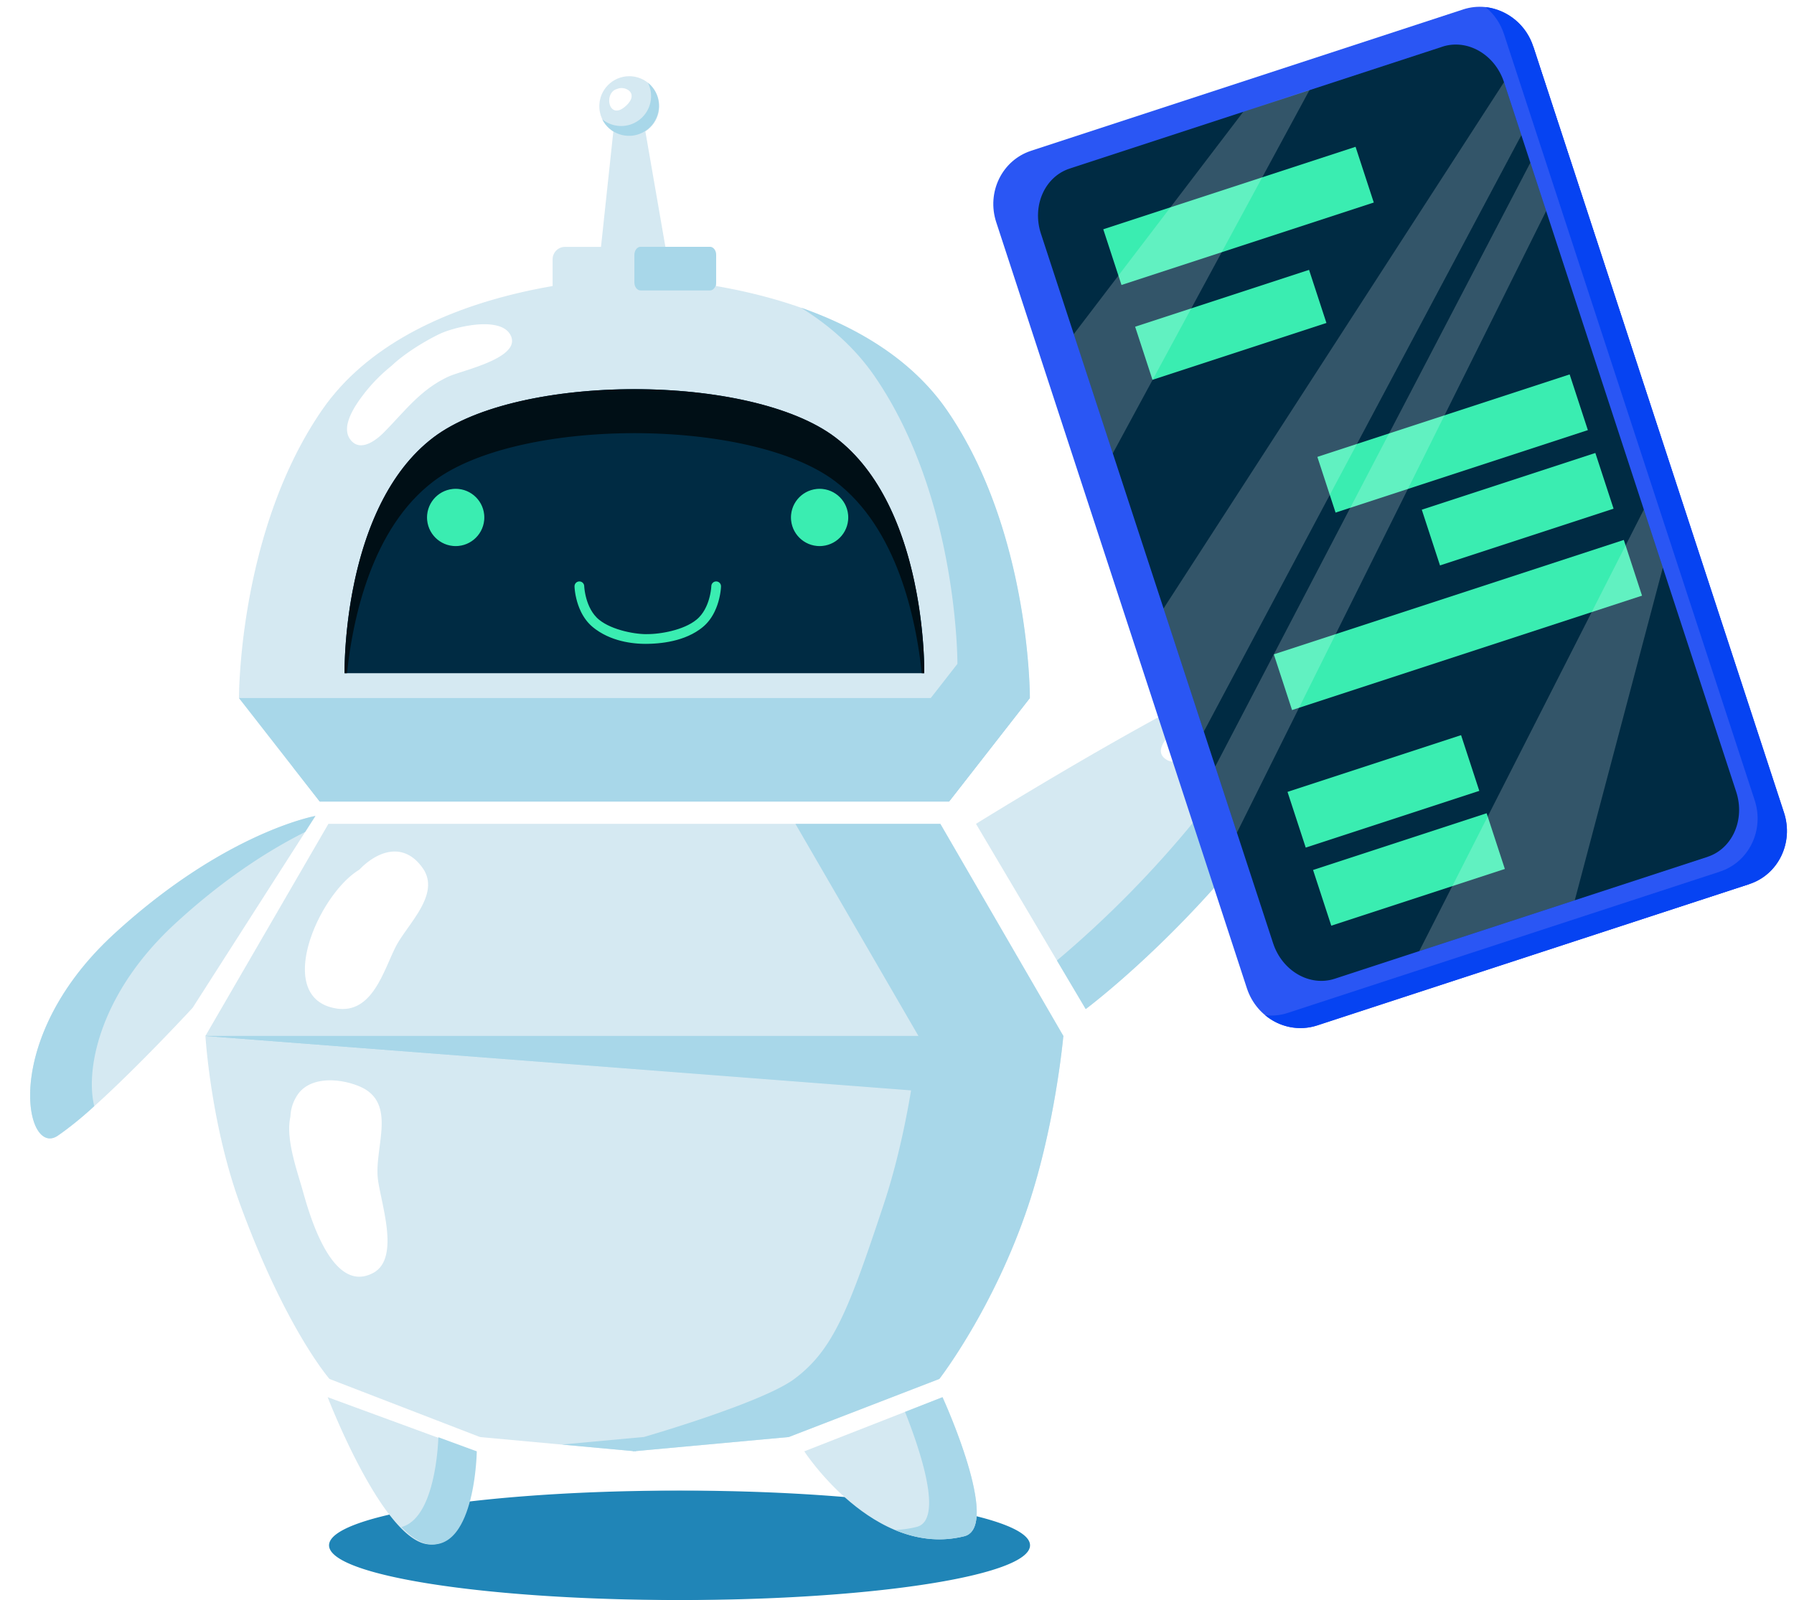
What is Chat-GPT?
Generative Pre-trained Transformer
is a large-scale language model (machine learning / Artificial Intelligence) developed by OpenAI, that uses deep learning techniques to generate human-like text.
GPT can be fine-tuned for different natural language processing tasks such as :
Translation
Text summarization
Question answering
Text generation

Slide 4

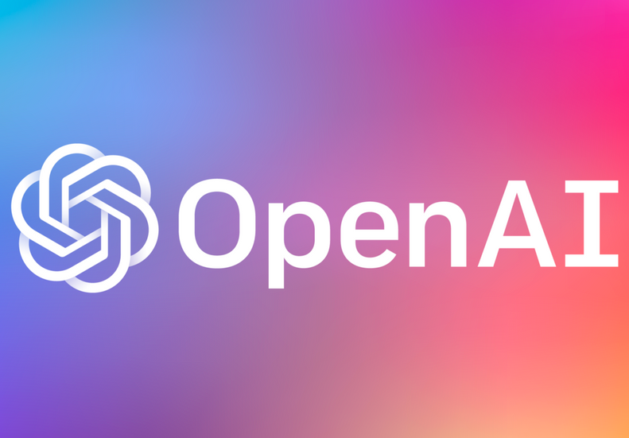

Who's behing it?
OPEN AI
an AI and research company with the stated goal of promoting and developing friendly AI in a way that benefits humanity as a whole.
Founded in December 11, 2015 by Sam Altman, Elon Musk, and others,. who collectively pledged $1 billion USD for the company.

Slide 5





Playground
TEXT-TO-NEXT it the ancestor of Chat-GPT. A predictive writing tool that allows you to generate text.
TEXT-TO-CONTEXT It interacts in a conversational way (chat-like). The dialogue format makes it possible for ChatGPT to answer question whenever asked via a "prompt".
Chat-GPT
OpenAI's projects
Dall.e
TEXT-TO-IMAGE Genarated images from Text. It helps create realistic images and art from a description in natural language.
TEXT-TO-CODE It can turn text prompts written in English or another natural language it's been trained on into corresponding lines of code.
OpenAI Codex

Slide 6

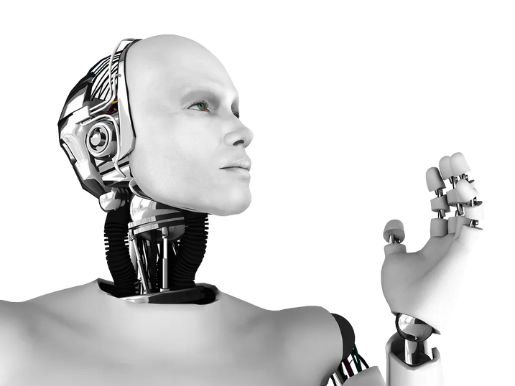
Why the Hype / Fuss ?
Limitless possibilities
with this teachnology, Your only limitation is you creativity level. The crazier you are, The better it is .
It's surely brings concerns such as ethical and Secury-related ones :
為什麼？
Plagiarism
Ill-intent users - cyber security concerns
Intellectual property
To Open-source or not to Open-source ?

Slide 7
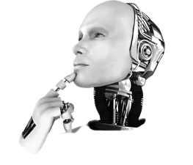
Limitations
wait a minute.......
Although it offers limitless possibilities. it can have the opposite effect as people might let the system do all the task for them ( prooblem for students...)
Chat-GPT Isn't Always Right ?
Bias Is Baked Into the System - as the data came from humans
Create a generation of lazy people.. oops !
Sometimes , it's at full capacity. You'll have to wait

Slide 8


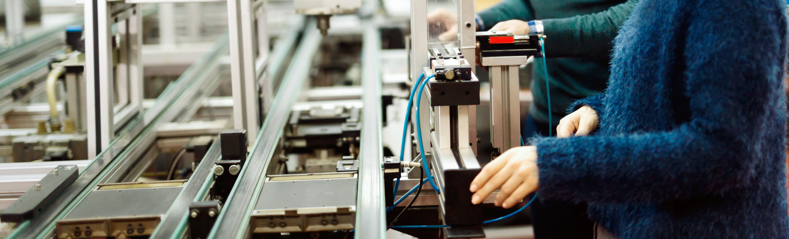
Use cases
You can use chat Chat-GPT (as an alternative to google) to do anything text- related such : write a synopsis of movie. Write a meal plan? translate a document/sentence with context. Solve, fix, debug codes. solve mathematical problems.etcs...

Slide 9
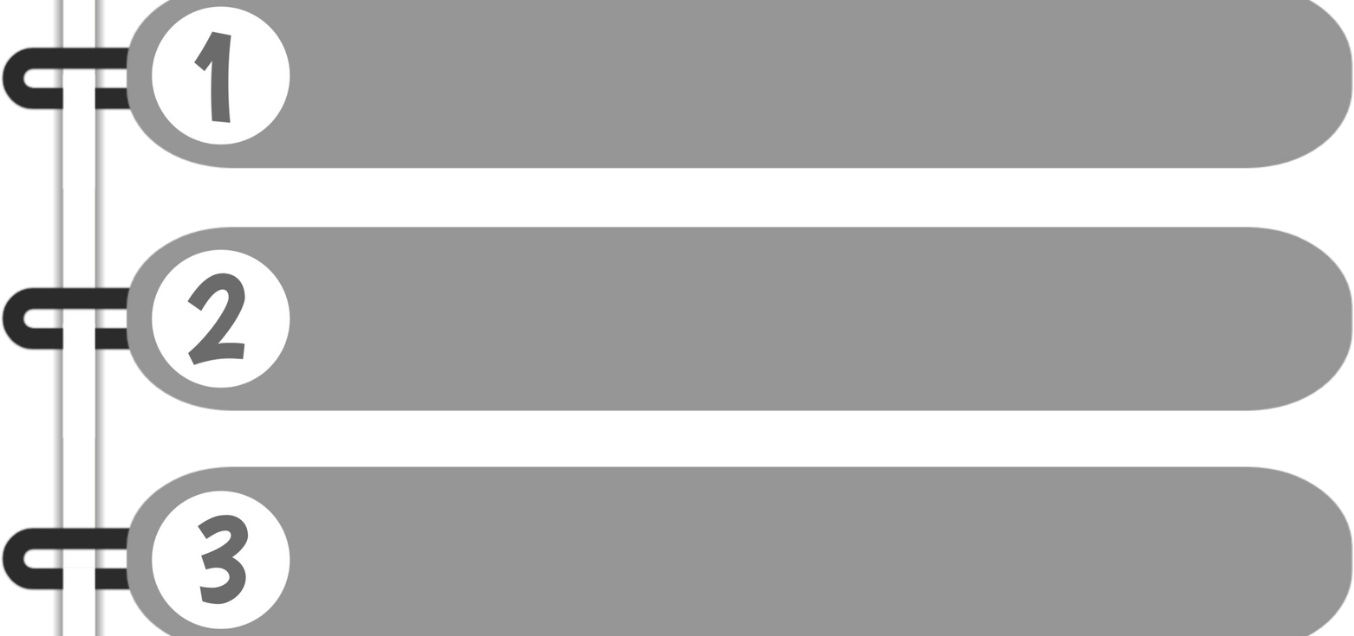


How to use Chat-GPT ?
Go to https://chat.openai.com/
Signup / login
Start to use it by typing your "prompt"

Slide 10

Importance of the "prompt"
Because it relies on your input : What you input and how use input it matters.
Specific keywords are important to get a better answer.
Context matters.
Example of a prompt : " Can you create a 7-day meal plan for an adult with limited budget who needs to consume 1500 calories per day, but make it lactose- intolerance-friendly?. "

Slide 11
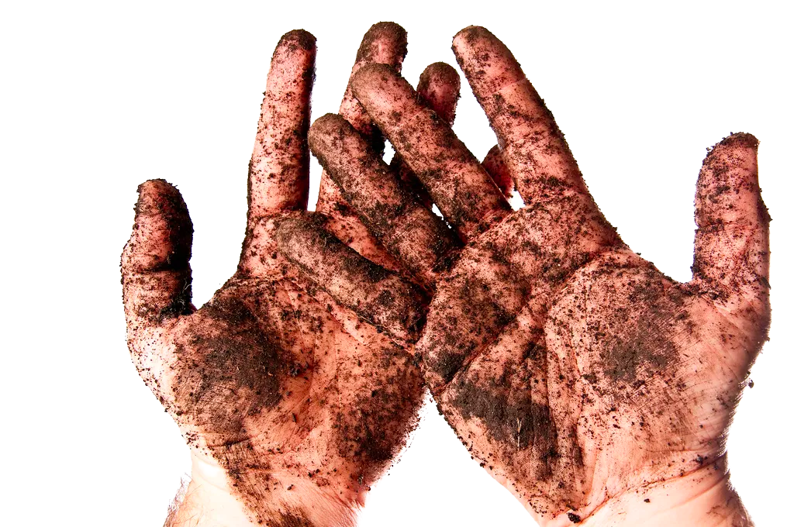
Lets get our hands dirty !

Slide 12
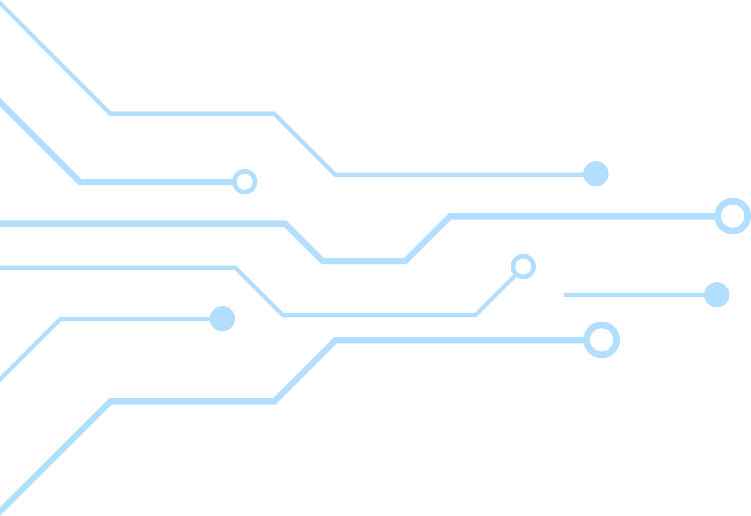




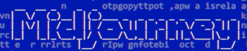
Alternatives-ish
Jenni.ai
Midjourrney
DeepL
Synthesia
Text prediction
Text-to-image
Translation
Text-to-Video

Slide 13
Conclusion
GPT is a powerful language model that can be fine-tuned for different natural language processing tasks.
However, it has some limitations and ethical concerns that need to be addressed.
Future developments in GPT technology will focus on improving the model's ability to generate coherent and unbiased text, as well as addressing ethical concerns.

Slide 14
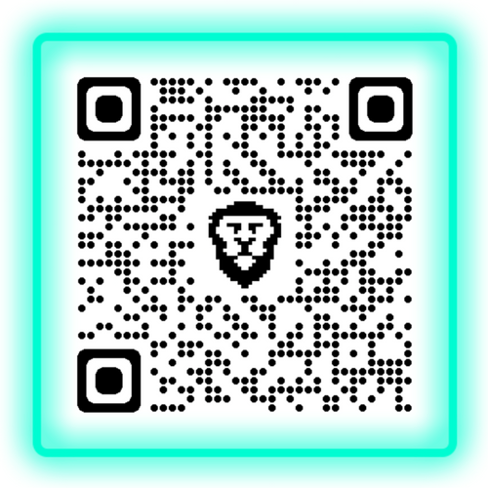
THANK YOU
Q&A
Please subscribe to my Channel for further details/videos
https://www.youtube.com/@tem10w

